Slide 1
Xiangyang Shi
October 9th

Slide 2
this week
a few questions
plan

Slide 3
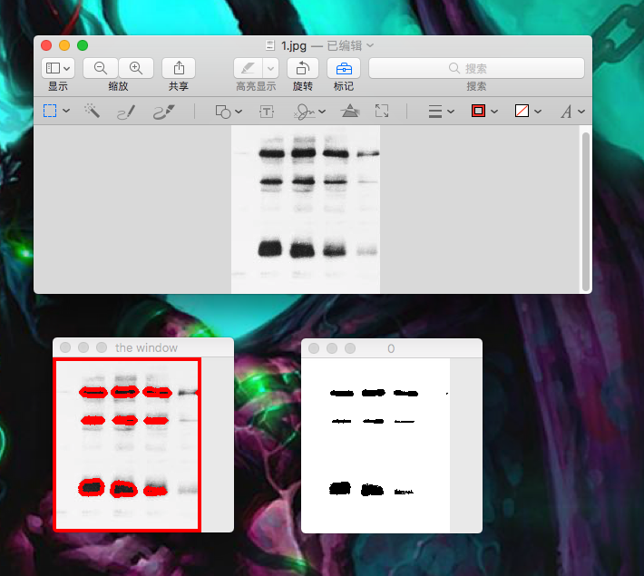
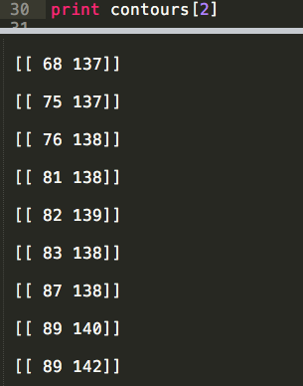
Find a contour
Set a threshold
(the result will become crude)
Find the contour of the output
Coordinates of each contours

Slide 4
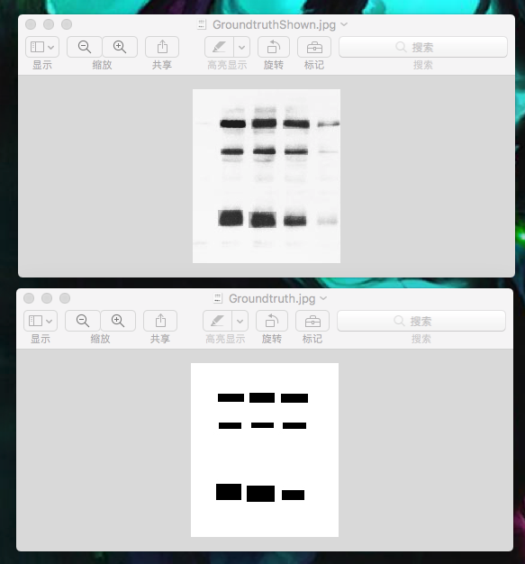

Design a metric
First we can set some ground truth. (Maybe not good)
We can run our algorithm
We can go through all the pixels.
By (a XOR b)/( a Union b)
Get a evaluation about the correctness of our algorithm

Slide 5
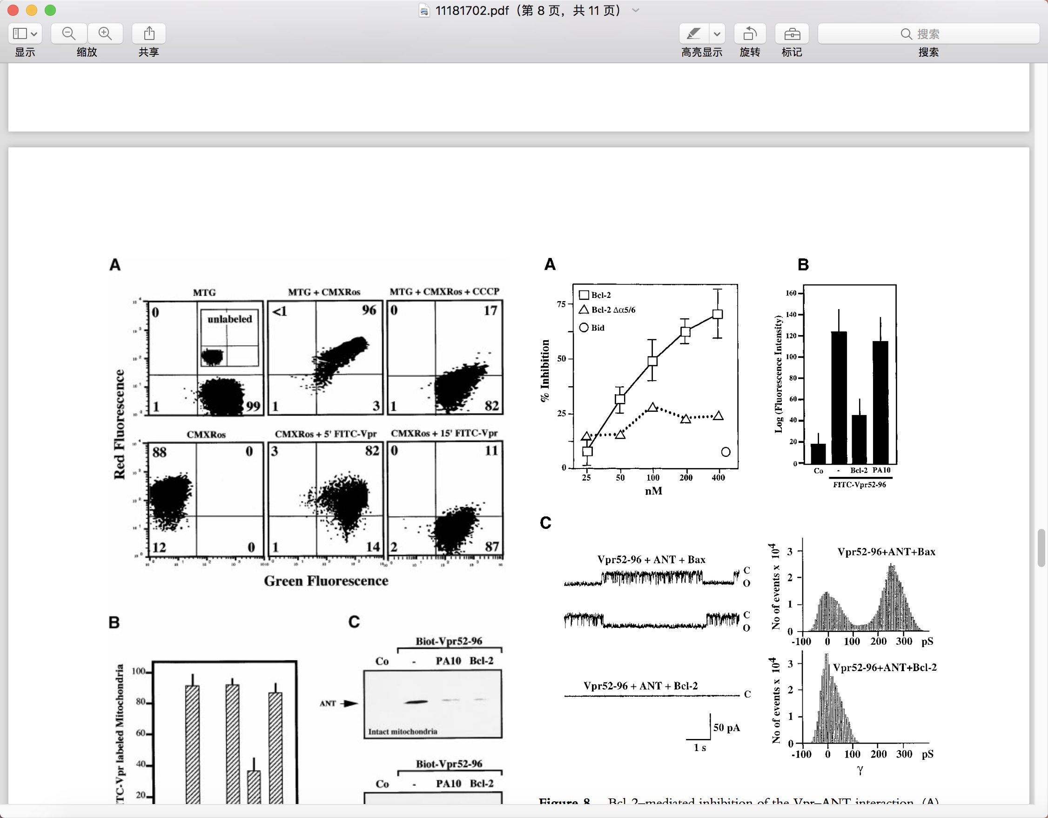
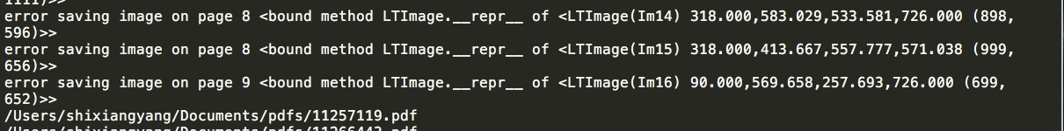
Questions
The script can catch the coordinates of images.
Not always works. I can follow if necessary.

Slide 6
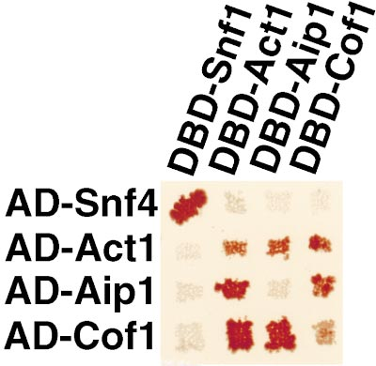
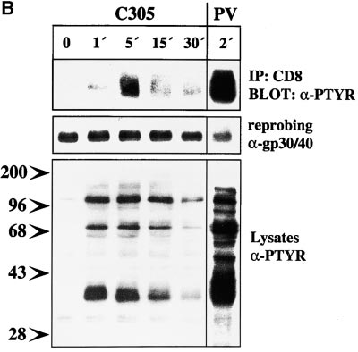
Question
We need to develop our own OCR
Some texts are embedded in the image
For our text contains even Greek Alphabet
Some texts are not vertical and horizontal

Slide 7
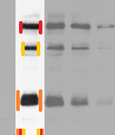
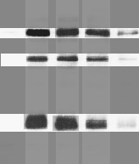
Plan-find a row
Interval union methods to find a column or row.
Since we can get the coordinates of the contours, so we can get the bounding box data.

